Slide 1

HONOLULU 311
Adriana Bartlett Gray

Slide 2
Objective & Background
Analyze data from the Honolulu 311 system to see if we can glean any insights that would be useful for…
City and County of Honolulu
Encompasses all cities within the Island of Oahu and only Oahu
Hawaii Tourism Authority
Residents
Honolulu 311 is the application developed by the City & County’s IT Dept for Residents to report non-urgent (non-911) issues to the county.

Slide 3
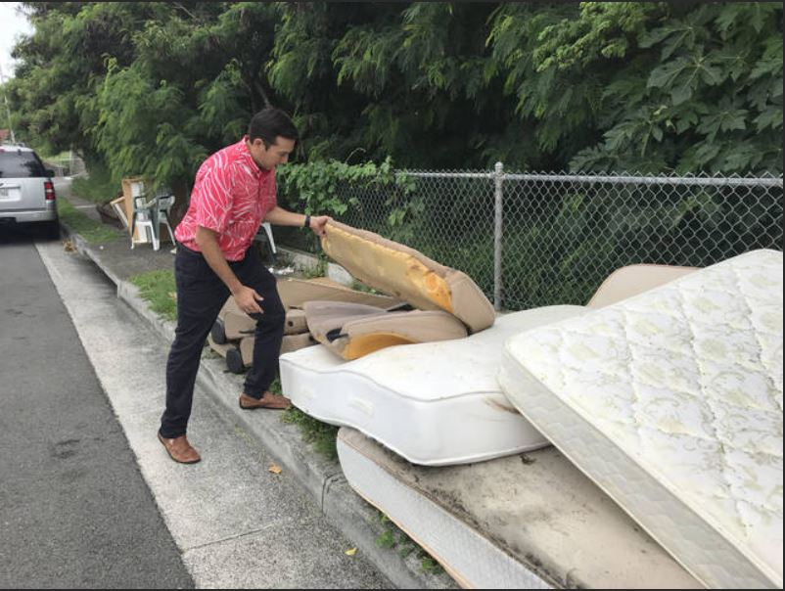
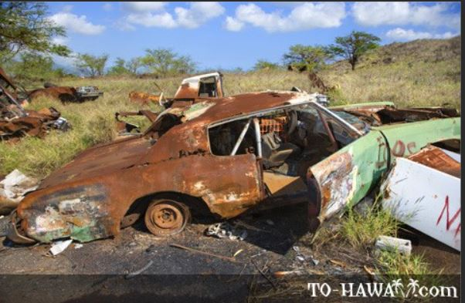
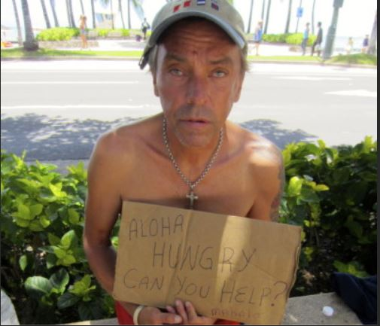
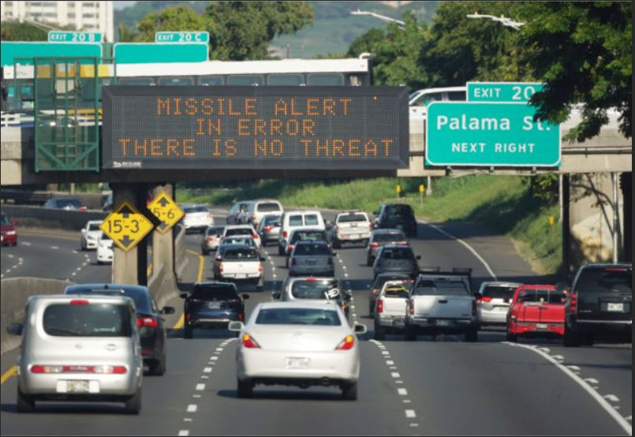
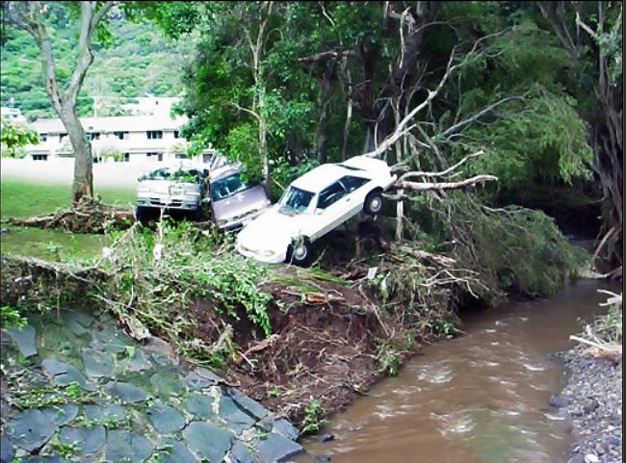
Who CARES? Welcome to paradise!

Slide 4
Primary data from Honolulu 311 archive
Available on data.gov
Approx 24,000 records w/7 variables
Unique ID, Report Type, Status
Create & Closed Dates (saved as string)
Spanning approx 8 years (2011-2018)
Latitude & Longitude (in one field)
Text Description of Issue being Reported
Opportunities for Analysis
By Report Type, Status, Dates
By TimeSpan through Lubridate
By City through Reverse Geocoding
Text Analysis

Slide 5
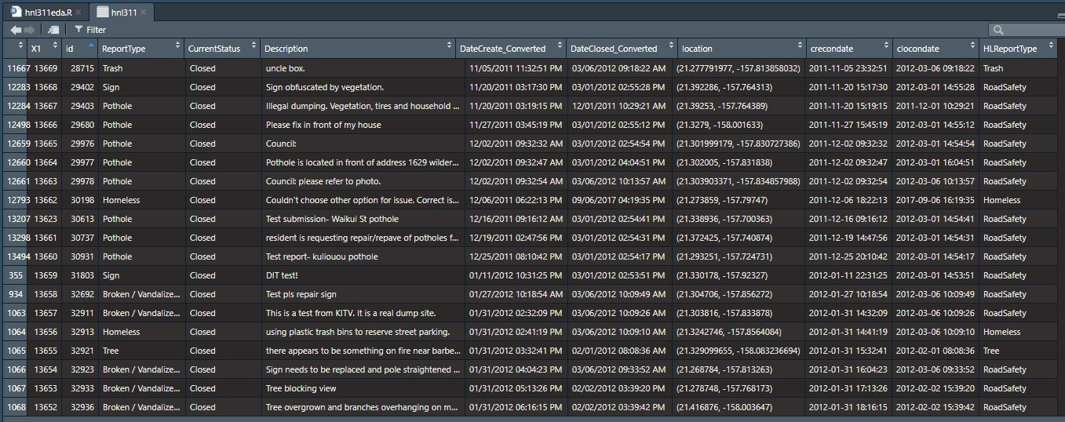

Slide 6
Mutated and AugmentED data
Adding calculation for Duration from Open to Closed
Creating Higher Level Category for ReportTypes (for easier visualization)
Splitting apart Latitude & Longitude to Utilize Reverse Geomapping
Utilized Texas A&M free reverse geomapping service
Created a sample file w/less than 2500 records (free limit) and only unique id, latitude, and longitude included
Uploaded for batch processing service
Returned file includes added address components to be joined back
… and a happy discovery… their ComputedCity = CDP (Census Designated Place)
Joining Census Education Data through ComputedCity/CDP
Joining Census Median Home Price through ComputedCity/CDP
Creating Higher Level Category for ComputedCity/CDP (by ‘Area’)
Creating Spans of Median Home Price to use as a categorical instead of continuous variable

Slide 7
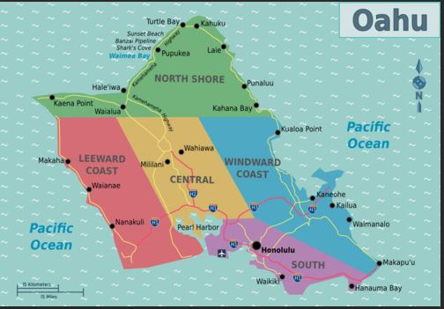
Grouping cities into areas

Slide 8
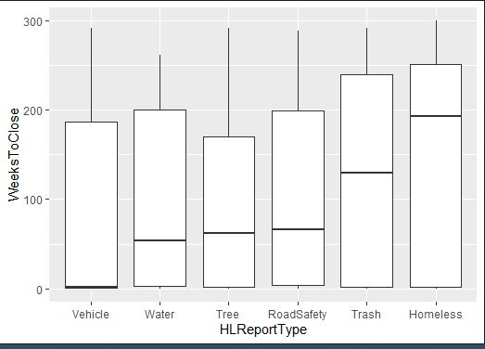
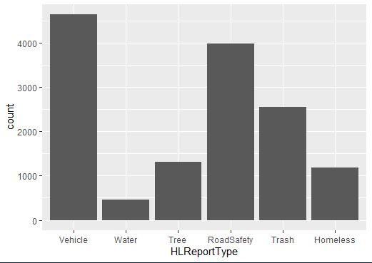
All of OAHU: by TTC & count

Slide 9
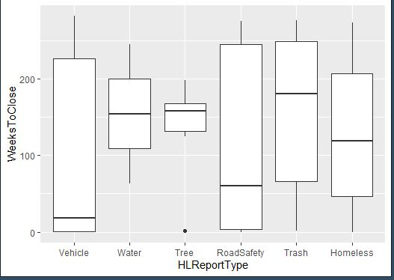
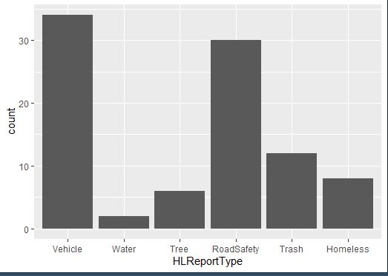
By AREA: windward TTC & count

Slide 10
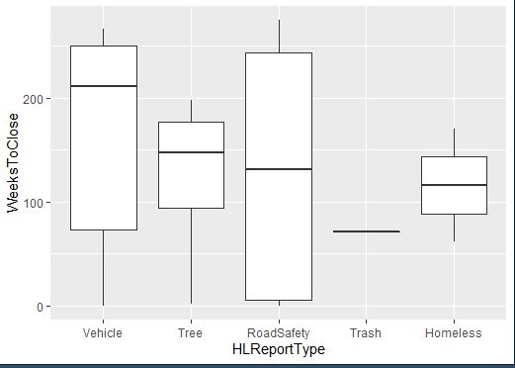
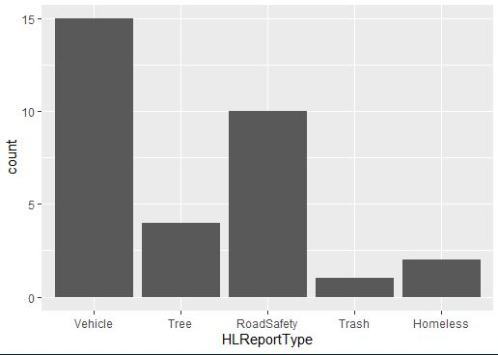
By CITY: KANEOHE TTC & COUNT

Slide 11
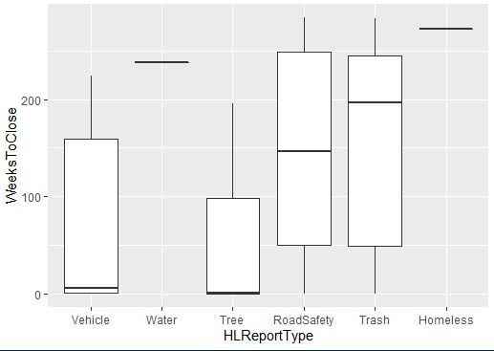
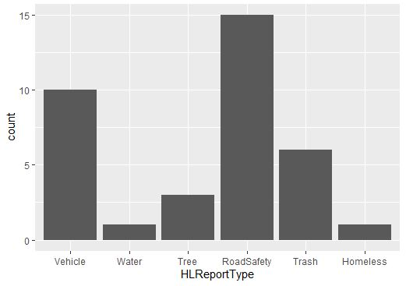
By MHP range: 900KS TTC & COUNT

Slide 12
NEXT STEPS: FUTURE WORK
Hire a Shiny Application Developer!!! :-D
Seriously, though…
Invest more time into finding a reverse geocode service that will process all 24k records for free
Text analysis… including Hawaiian Pidgin English words (pilau, kapakahi, etc.)
Analyze more census data joined w/this data
Contact C&C of Honolulu Dept of IT Management to see if I can get a brief meeting w/one of their IT business analysts to better understand the modeling and actual use of this data… am I using it in an appropriate way?
Ask around to see what my family/friends/contacts in Hawaii think about the lengthy mean and median durations for closing these sorts of issues/reports. Get different perspectives… surprising, not surprising?
About Me…
https://github.com/abartlettg/hnl311

